Slide 1
Diabetes Prediction Using ML Algorithms
Presented by:
Muhammad Umer (23010112-005)
Muhammad Irtisam (23010112-006)
Fatima Nasir (23010112-015)
Rizwa Asad (23010112-016)

Slide 2

Introduction: Importance of Early Prediction
Demographics
Medical History
Age and gender data points are crucial.
Hypertension and heart disease are key indicators.
Lifestyle Factors
Biochemical Markers
Smoking habits and BMI are carefully analysed.
HbA1c and blood glucose levels are vital.
Our project focuses on predicting diabetes early using machine learning.

Slide 3
Why Early Prediction Matters
Prevents Complications
Personalised Treatment
Early detection can prevent severe health complications.
AI models support tailored risk assessments for patients.
Cost-Effective Care
Improved Outcomes
It significantly reduces overall healthcare expenses.
This leads to better patient outcomes and system efficiency.

Slide 4
Literature Review Methodology
We reviewed several studies by key authors.
Feature Engineering
Enhances model accuracy significantly.
LGBM Performance
Achieved an impressive 82.91% accuracy.
Neural Networks
Demonstrated an 88.6% accuracy rate.
AdaBoost Results
Showed the highest accuracy at 98.8%.
Interpretability
Logistic regression aids model understanding.
Findings highlight various algorithm strengths.

Slide 5
Data Collection and Dataset
Our dataset is comprehensive.
Dataset Description
Usefulness
Includes age, gender, BMI, and more.
Aids in identifying high-risk individuals.
Labels identify diabetic versus non-diabetic cases.
Supports research into diabetes risk factors.
Crucial for developing predictive models.
This allows for robust model training.

Slide 6
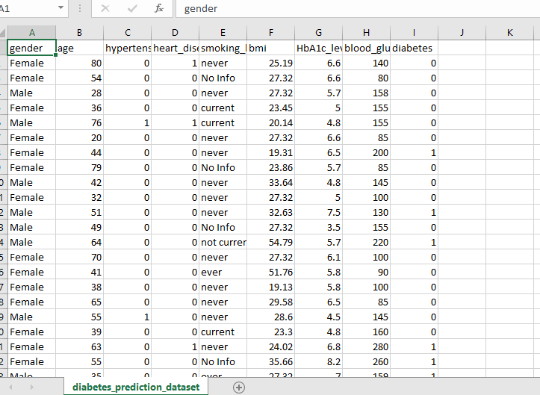

Slide 7




Data Preprocessing Steps
Effective preprocessing ensures data quality.
Duplicate Removal
Ensures unique and clean data records.
Feature Elimination
Removed 'gender' due to its low relevance.
Data Transformation
Prepares data for machine learning algorithms.

Slide 8

Train-Test Split and Algorithms
We used an 80/20 split for robust evaluation.
Data Split
Algorithms
80% for training, 20% for testing.
Decision Tree, Linear Regression, Random Forest, Naive Bayes.
Metrics
Accuracy, Precision, Recall, and F1-score assessed.

Slide 9
Decision Tree Algorithm Performance
The Decision Tree model achieved high accuracy.
Accuracy
0.97
Precision
1.00
Recall
0.68
F1-score
0.81

Slide 10
Naive Bayes Algorithm Performance
Naive Bayes demonstrated balanced results.
Accuracy
0.90
Precision
0.466
Recall
0.558
F1-score
0.507

Slide 11
Random Forest Algorithm Performance
Random Forest exhibited strong predictive capabilities.
Accuracy
0.969
Precision
1.00
Recall
0.677
F1-score
0.808

Slide 12
Linear Regression Algorithm Performance
Precision
1.00
Recall
0.302
F1-score
0.464

Slide 13
Model Results Summary
Best Model: Random Forest
Runner-up: Decision Tree
Poor Performer: Linear Regression
Achieved 97% accuracy and an F1-score of 0.80, demonstrating strong predictive capabilities.
Performed well as a secondary option, showing solid accuracy.
Not suitable for classification tasks in this context, yielding low performance metrics.

Slide 14
Model Performance Comparison
Model
Accuracy
Precision
Recall
F1-score
Random Forest
0.97
0.85
0.76
0.80
Decision Tree
0.96
0.80
0.66
0.72
Naive Bayes
0.94
0.65
0.54
0.59
Linear Regression
-
0.50
0.30
0.37

Slide 15
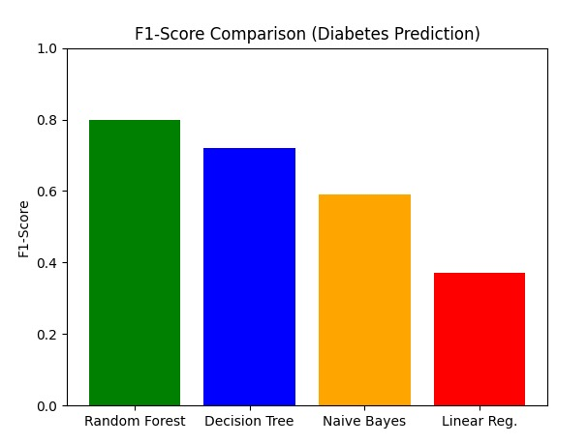

Slide 16
Conclusion
Top Performer: Random Forest
Interpretability Alternative: Decision Tree
Not Recommended: Linear Regression and Naive Bayes
Achieved the best F1-score and demonstrated robust handling of the data, making it the most effective model for diabetes prediction in this study.
Offers a good balance of accuracy and interpretability, providing a viable option when understanding feature importance is crucial.
Linear Regression showed poor performance for this classification task. Naive Bayes, while showing balanced results, was less robust than ensemble methods due to its strong independence assumptions, limiting its practical application here.

Slide 17
THANKYOU

